Slide 1
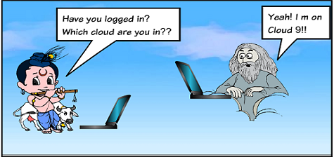
Cloud Computing 101
SAGAR UTEKAR
VMWare Software India PVT. LTD.

Slide 2

About me
Working as MTS3 Site Reliability Engineer @VMWare Software India PVT. LTD
Docker & CNCF Pune community Leader
Open-Source Enthusiast, A firm believer in the power of community education.
Google Summer Of Code Admin, Mentor, Mentee 2022 @PEcAn Project
CKS | CKA | CKAD | KCNA | Prometheus | Terraform Certified
Mentored 5000+ students & professionals across India for career guidance, Job Search, Open Source, Cloud Native
#GetFitWithSagar

Slide 3
What is Cloud ?

Slide 4
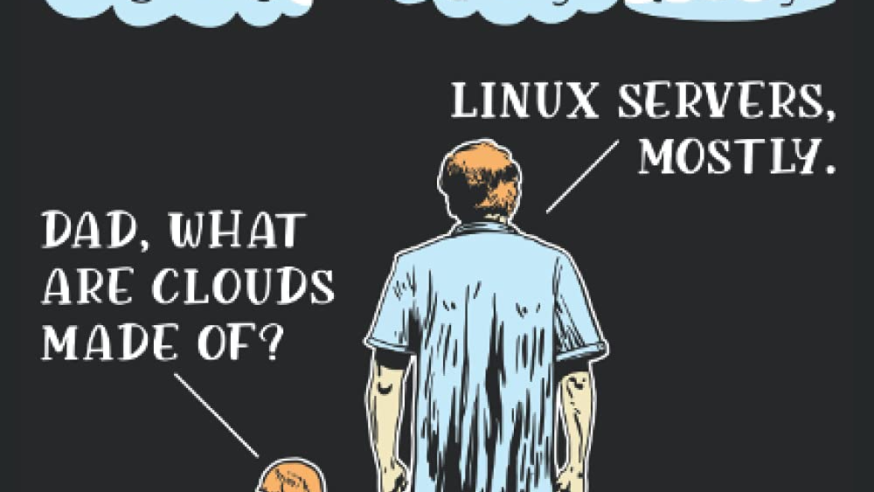
The cloud is not a physical entity, but instead is a vast network of remote servers around the globe which are hooked together and meant to operate as a single ecosystem. These servers are designed to either store and manage data, run applications, or deliver content or a service such as streaming videos, web mail, office productivity software, or social media. Instead of accessing files and data from a local or personal computer, you are accessing them online from any Internet-capable device—the information will be available anywhere you go and anytime you need it.

Slide 5
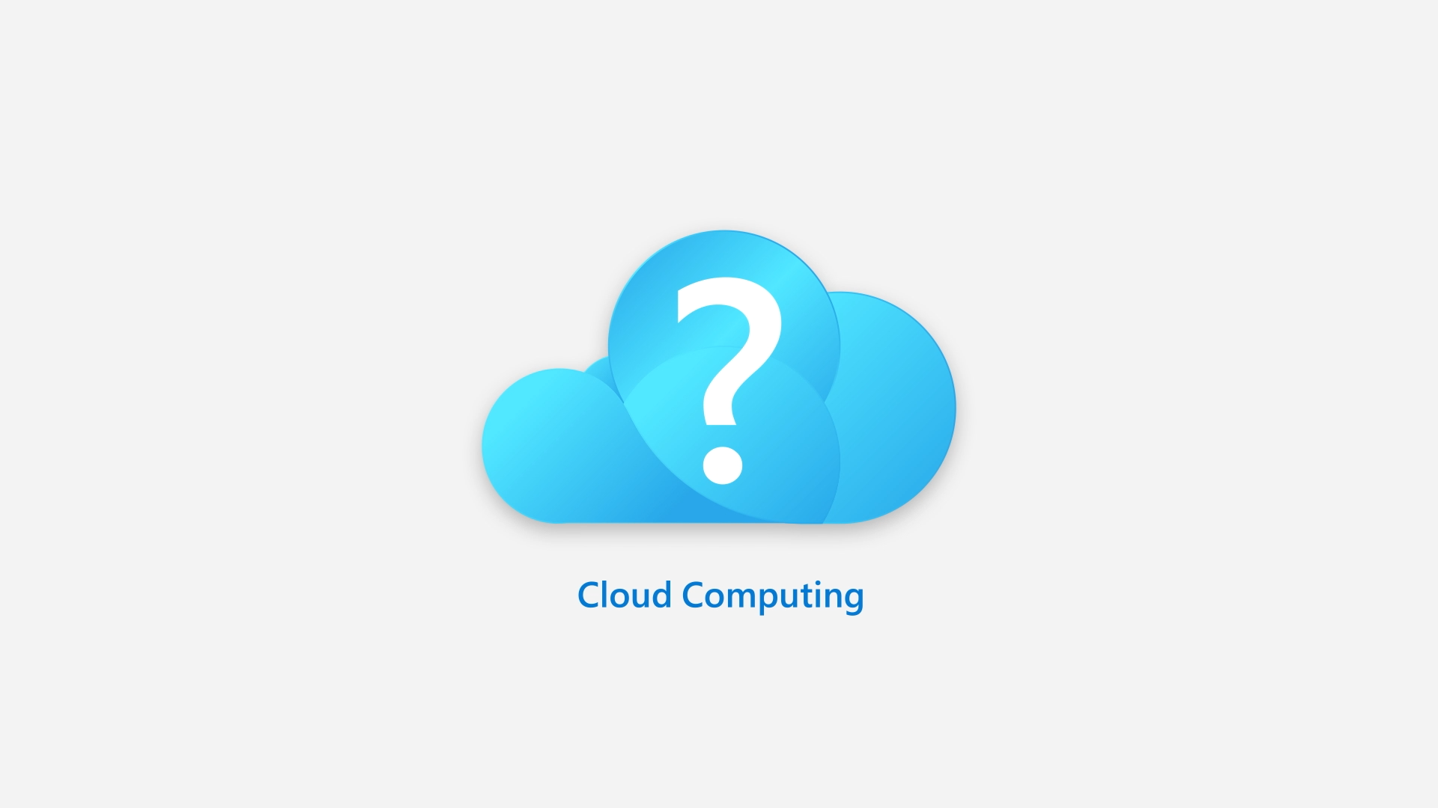
What is Cloud Computing ?
Cloud computing is a model for enabling ubiquitous, convenient, on-demand network access to a shared pool of configurable computing resources (e.g., networks, servers, storage, applications, and services) that can be rapidly provisioned and released with minimal management effort or service provider interaction. This cloud model is composed of five essential characteristics, three service models, and four deployment models.
Cloud computing is the delivery of computing services over the internet. Computing services include common IT infrastructure such as virtual machines, storage, databases, and networking.

Slide 6
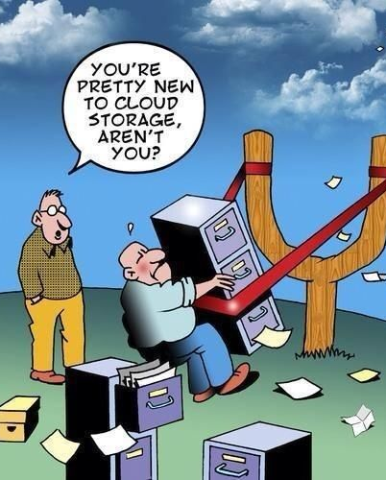
What is Cloud Computing ?
Cloud computing is a model for enabling ubiquitous, convenient, on-demand network access to a shared pool of configurable computing resources (e.g., networks, servers, storage, applications, and services) that can be rapidly provisioned and released with minimal management effort or service provider interaction. This cloud model is composed of five essential characteristics, three service models, and four deployment models.
Cloud computing is the delivery of computing services over the internet. Computing services include common IT infrastructure such as virtual machines, storage, databases, and networking.

Slide 7
Essential Characteristics

Slide 8
On-demand self service
A consumer can unilaterally provision computing capabilities, such as server time and network storage, as needed automatically without requiring human interaction with each service provider

Slide 9
Broad network address
Capabilities are available over the network and accessed through standard mechanisms that promote use by heterogeneous thin or thick client platforms (e.g., mobile phones, tablets, laptops, and workstations).

Slide 10
Resource Pooling
The provider’s computing resources are pooled to serve multiple consumers using a multi-tenant model, with different physical and virtual resources dynamically assigned and reassigned according to consumer demand.
There is a sense of location independence in that the customer generally has no control or knowledge over the exact location of the provided resources but may be able to specify location at a higher level of abstraction (e.g., country, state, or datacenter).
Examples of resources include storage, processing, memory, and network bandwidth.

Slide 11
Rapid Elasticity
Capabilities can be elastically provisioned and released, in some cases automatically, to scale rapidly outward and inward commensurate with demand.
To the consumer, the capabilities available for provisioning often appear to be unlimited and can be appropriated in any quantity at any time.

Slide 12
Measured service
Cloud systems automatically control and optimize resource use by leveraging a metering capability at some level of abstraction appropriate to the type of service (e.g., storage, processing, bandwidth, and active user accounts).
Resource usage can be monitored, controlled, and reported, providing transparency for both the provider and consumer of the utilized service.

Slide 13
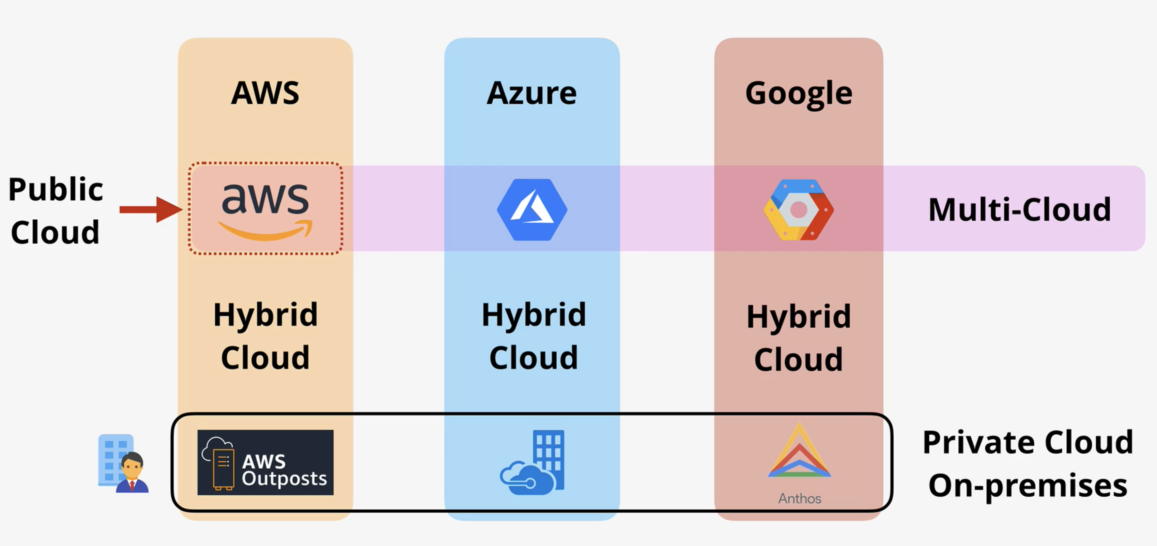
Cloud Models

Slide 14
Private Cloud
A private cloud is, in some ways, the natural evolution from a corporate datacenter.
It’s a cloud (delivering IT services over the internet) that’s used by a single entity.
Private cloud provides much greater control for the company and its IT department.
However, it also comes with greater cost and fewer of the benefits of a public cloud deployment.
A private cloud may be hosted from your on-site datacenteror dedicated datacenter offsite, potentially even by a third party that has dedicated that datacenter to your company.

Slide 15
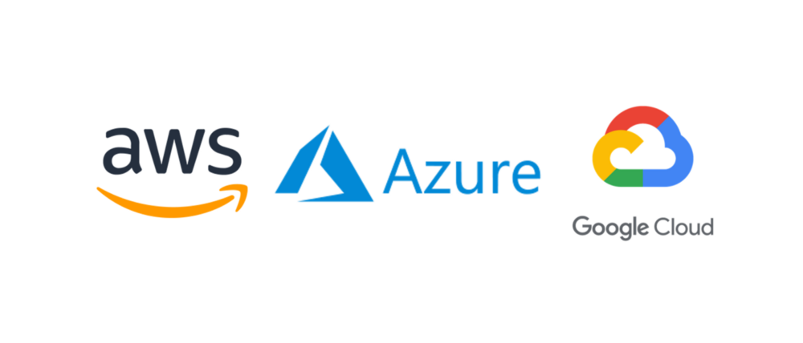
Public Cloud
A public cloud is built, controlled, and maintained by a third-party cloud provider.
With a public cloud, anyone that wants to purchase cloud services can access and use resources.
The general public availability is a key difference between public and private clouds.

Slide 16
Hybrid Cloud
A hybrid cloud is a computing environment that uses both public and private clouds in an inter-connected environment.
A hybrid cloud environment can be used to allow a private cloud to surge for increased, temporary demand by deploying public cloud resources.
Hybrid cloud can be used to provide an extra layer of security. For example, users can flexibly choose which services to keep in public cloud and which to deploy to their private cloud infrastructure.

Slide 17
Multi Cloud
A fourth, and increasingly likely scenario is a multi-cloud scenario. In a multi-cloud scenario, you use multiple public cloud providers.
Maybe you use different features from different cloud providers.
Or maybe you started your cloud journey with one provider and are in the process of migrating to a different provider.
Regardless, in a multi-cloud environment you deal with two (or more) public cloud providers and manage resources and security in both environments.

Slide 18
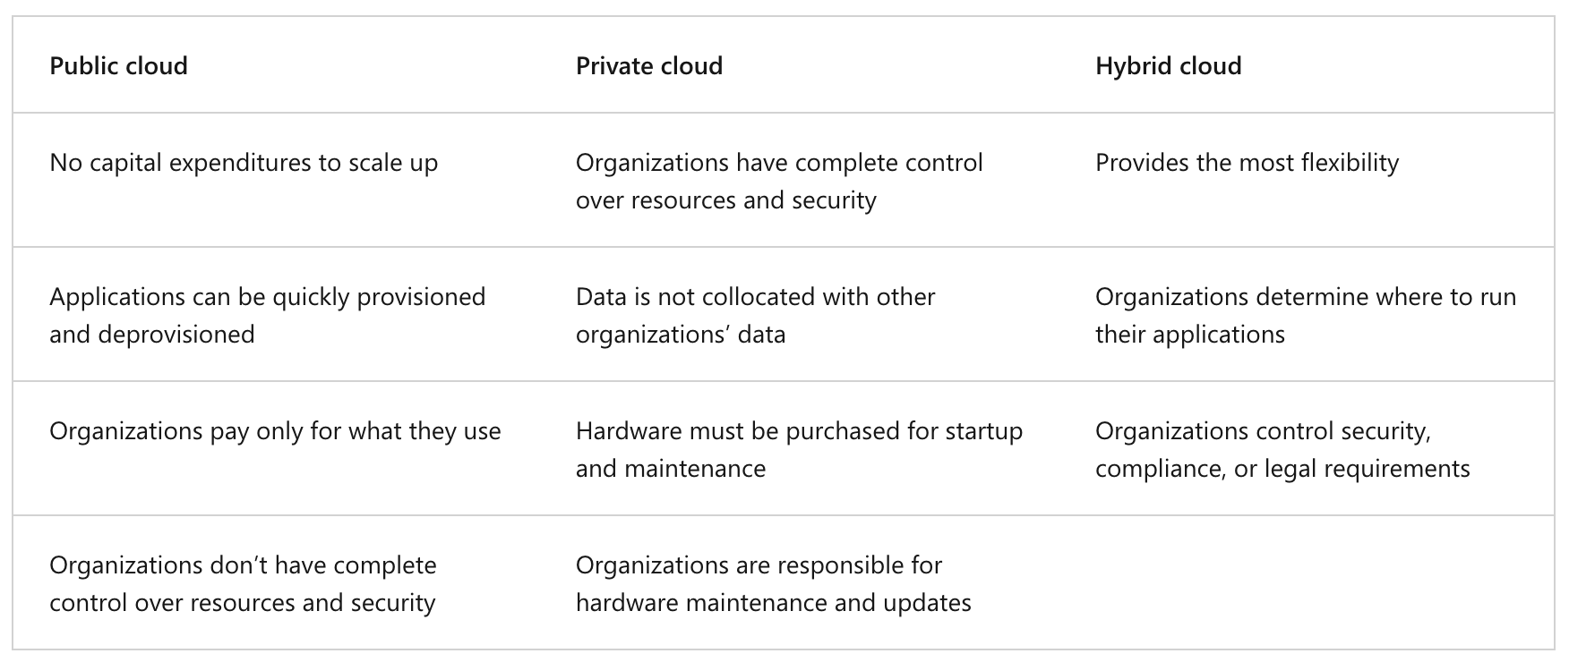
Key differences

Slide 19
Service Models

Slide 20
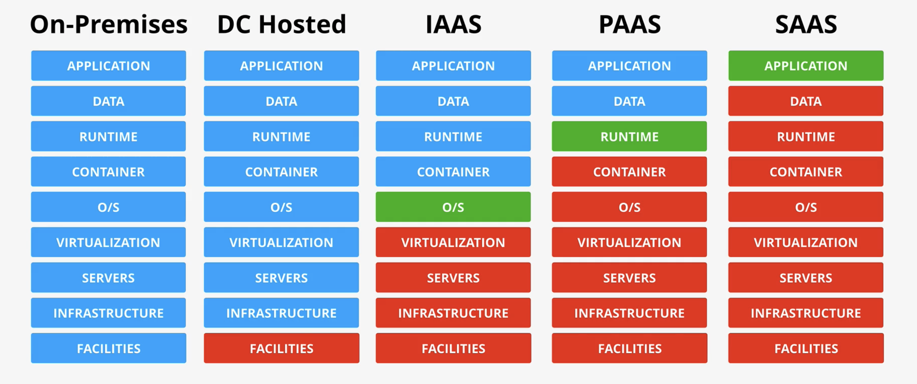

Slide 21
IaaS
The first cloud computing type is infrastructure-as-a-service (IaaS), which is used for Internet-based access to storage and computing power.
The most basic category of cloud computing types, IaaS lets you rent IT infrastructure - servers and virtual machines, storage, networks, and operating systems - from a cloud provider on a pay-as-you-go basis.
The service provider owns the infrastructure equipment and is responsible for housing, running, and maintaining it. The customer typically pays on a per-use basis.

Slide 22
PaaS
The second cloud computing type is platform-as-a-service (PaaS) that gives developers the tools to build and host web applications.
PaaS is designed to give users access to the components they require to quickly develop and operate web or mobile applications over the Internet, without worrying about setting up or managing the underlying infrastructure of servers, storage, networks, and data

Slide 23
SaaS
The third cloud computing type is software-as-a-service (SaaS) which is used for web-based applications.
SaaS is a method for delivering software applications over the Internet where cloud providers host and manage the software applications making it easier to have the same application on all of your devices at once by accessing it in the cloud.

Slide 24
Resources
https://cloud.google.com/learn/training
https://learn.microsoft.com/en-us/
https://aws.amazon.com/training/learn-about/
https://getfitwithsagar.graphy.com/
https://cloud.google.com/edu/students

Slide 25
My Journey

Slide 26
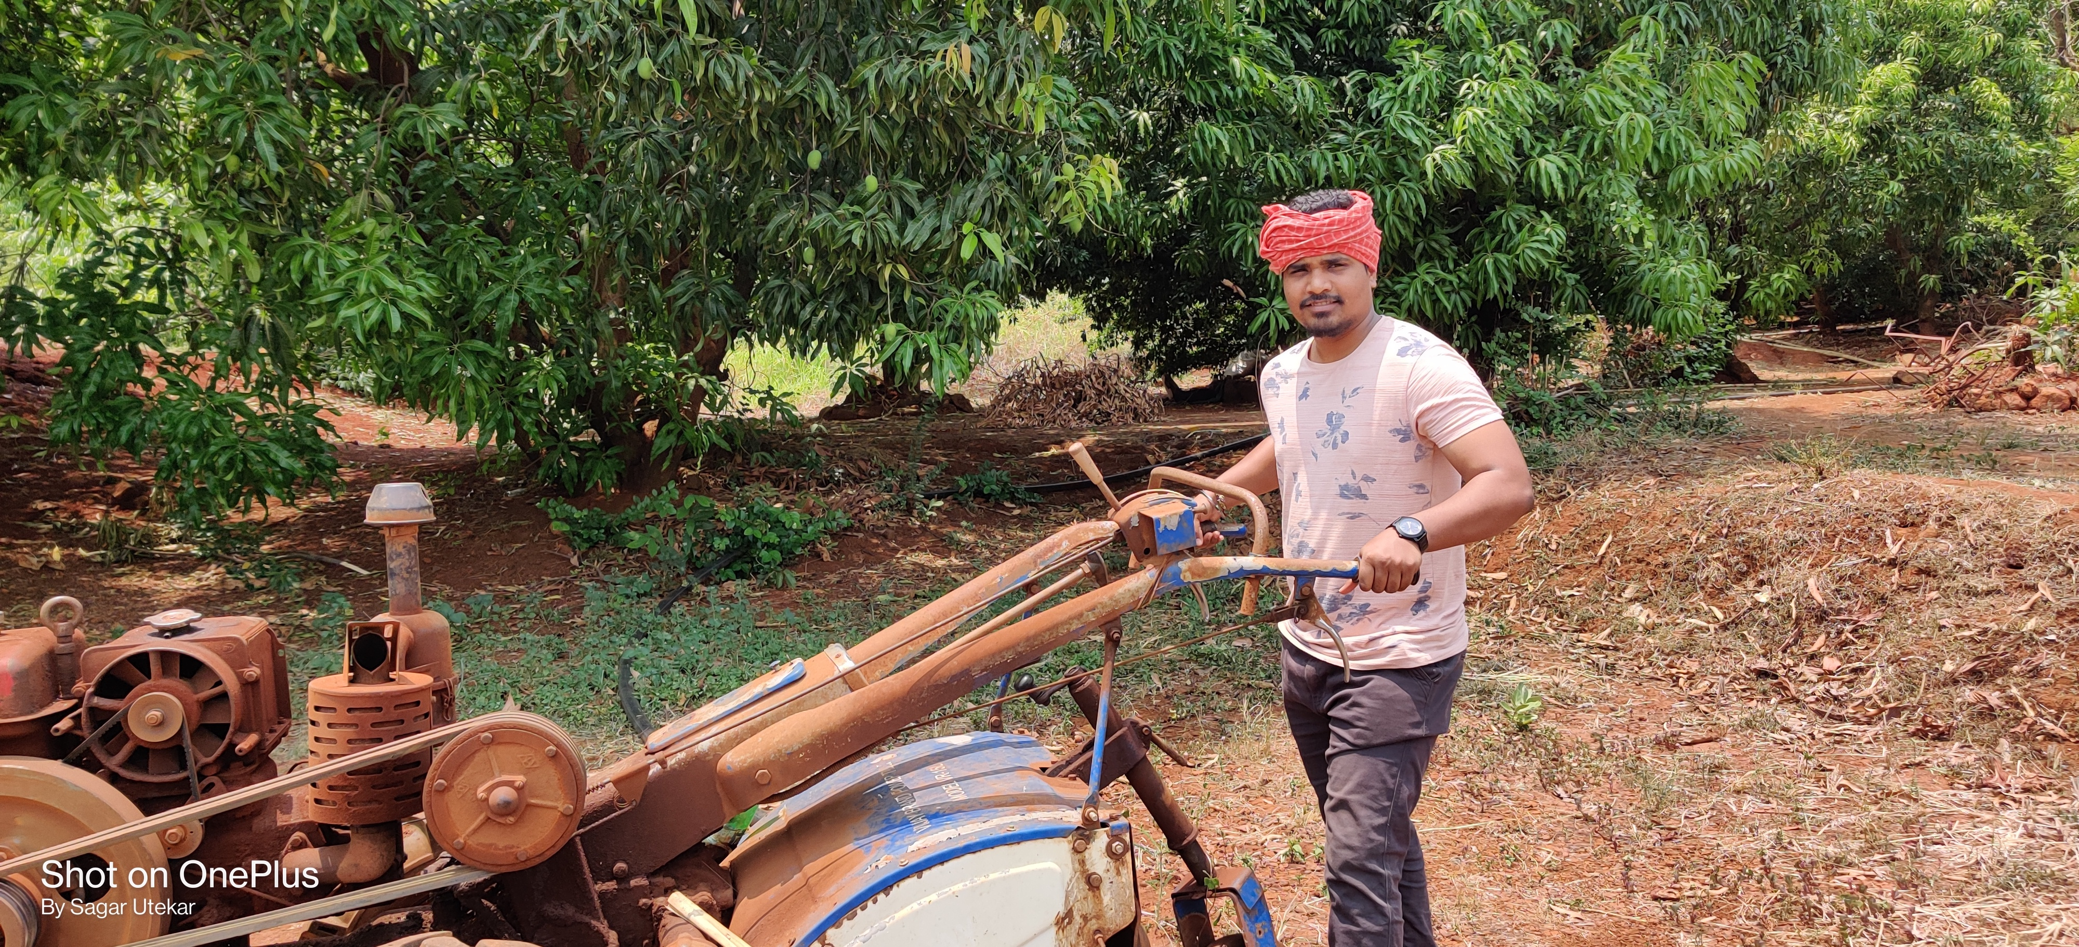
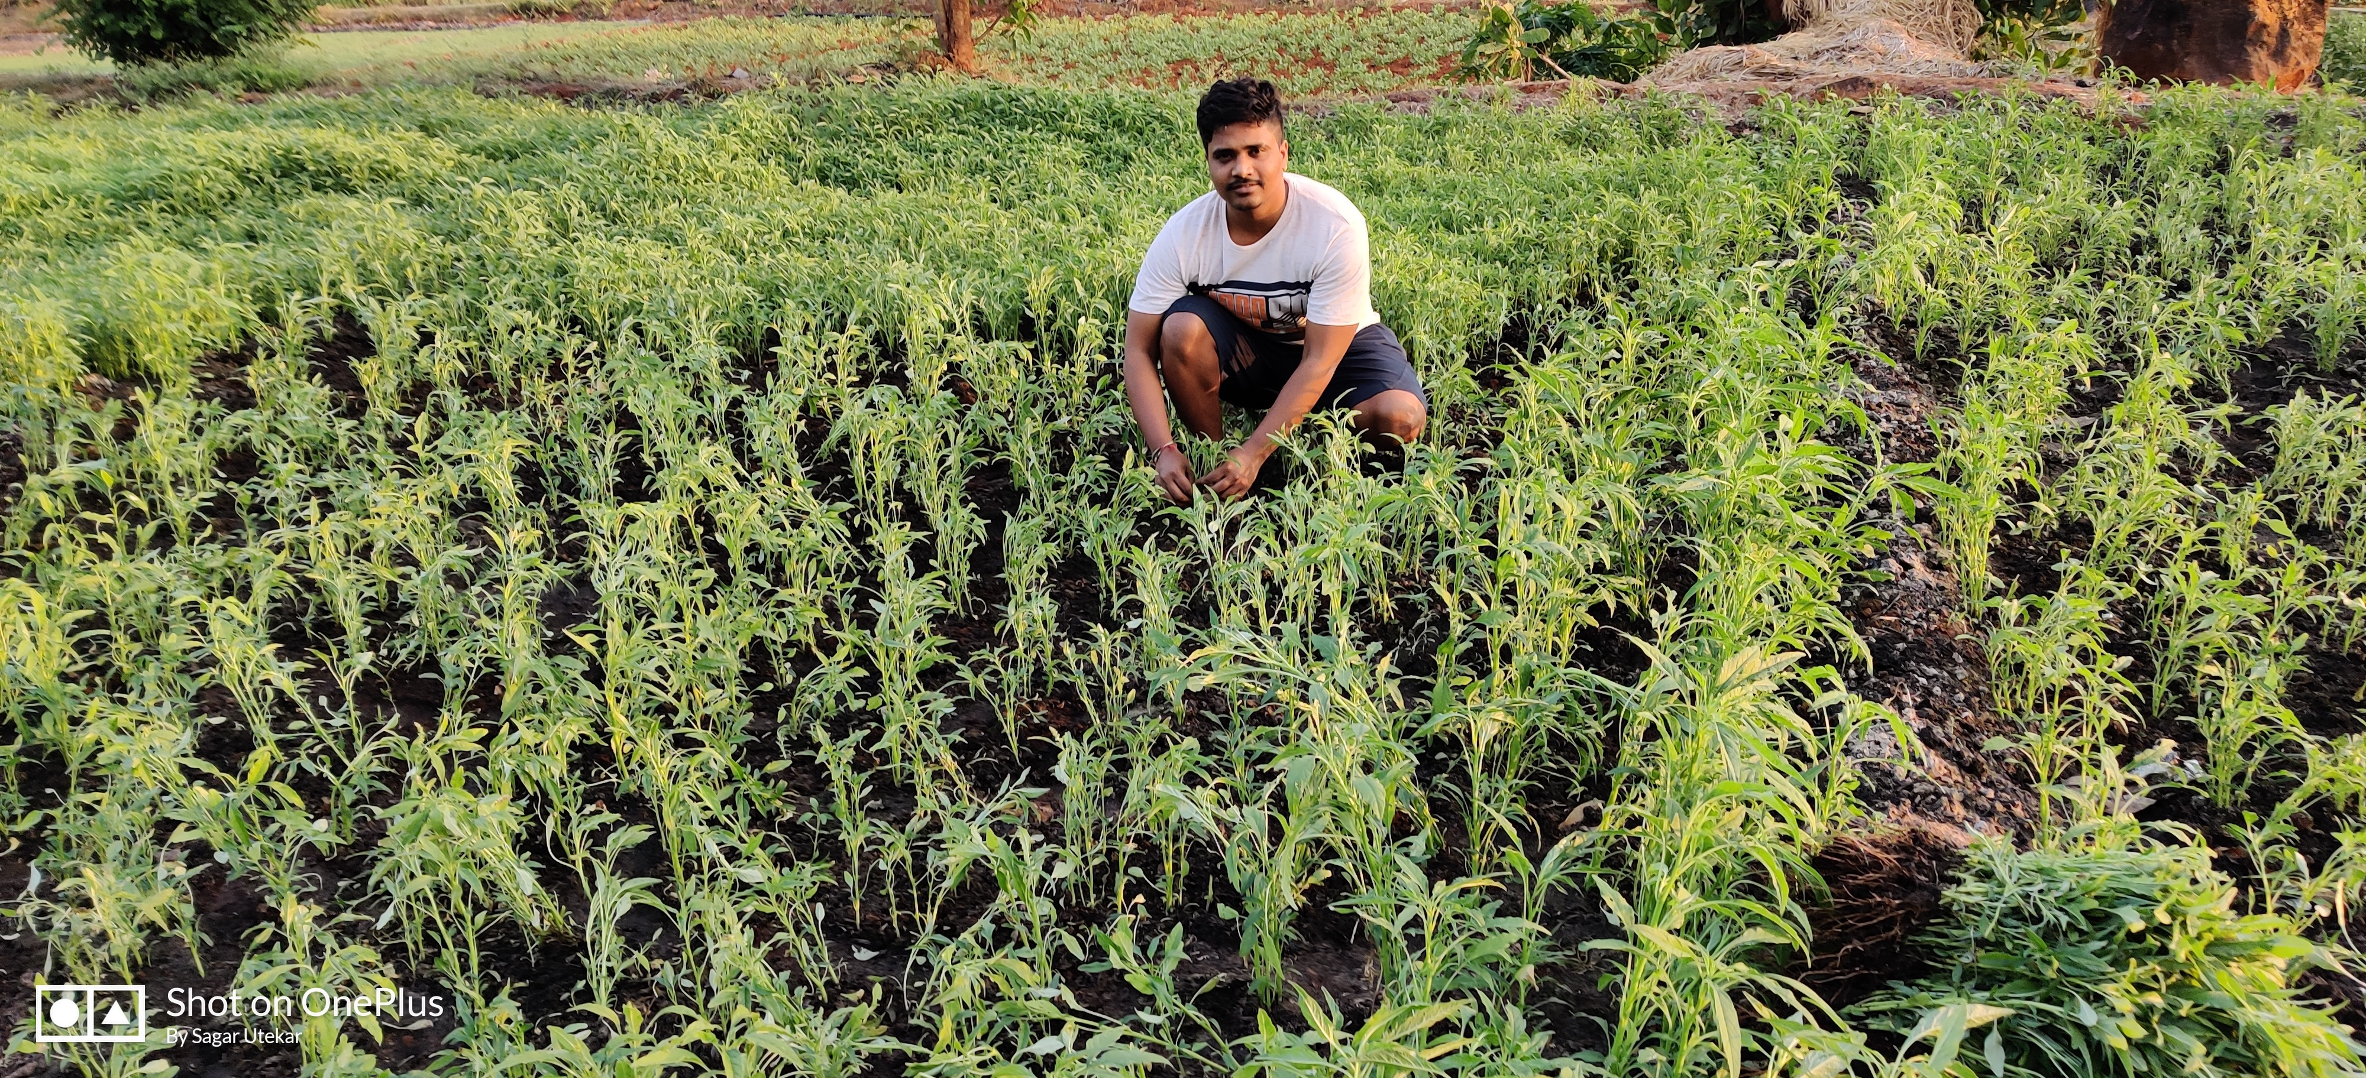
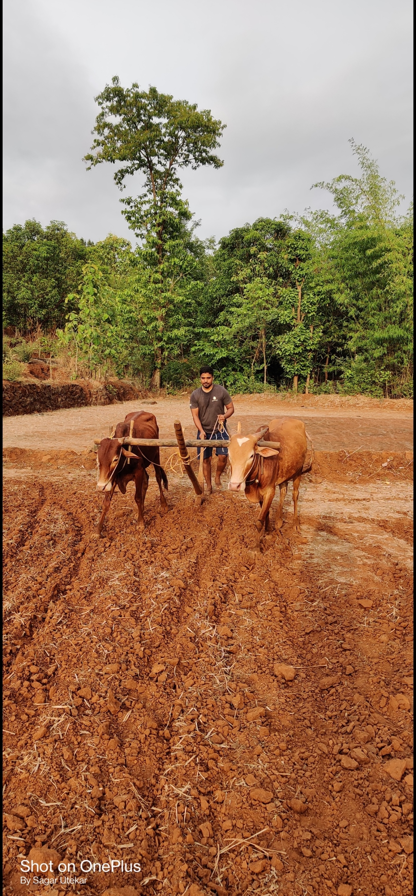
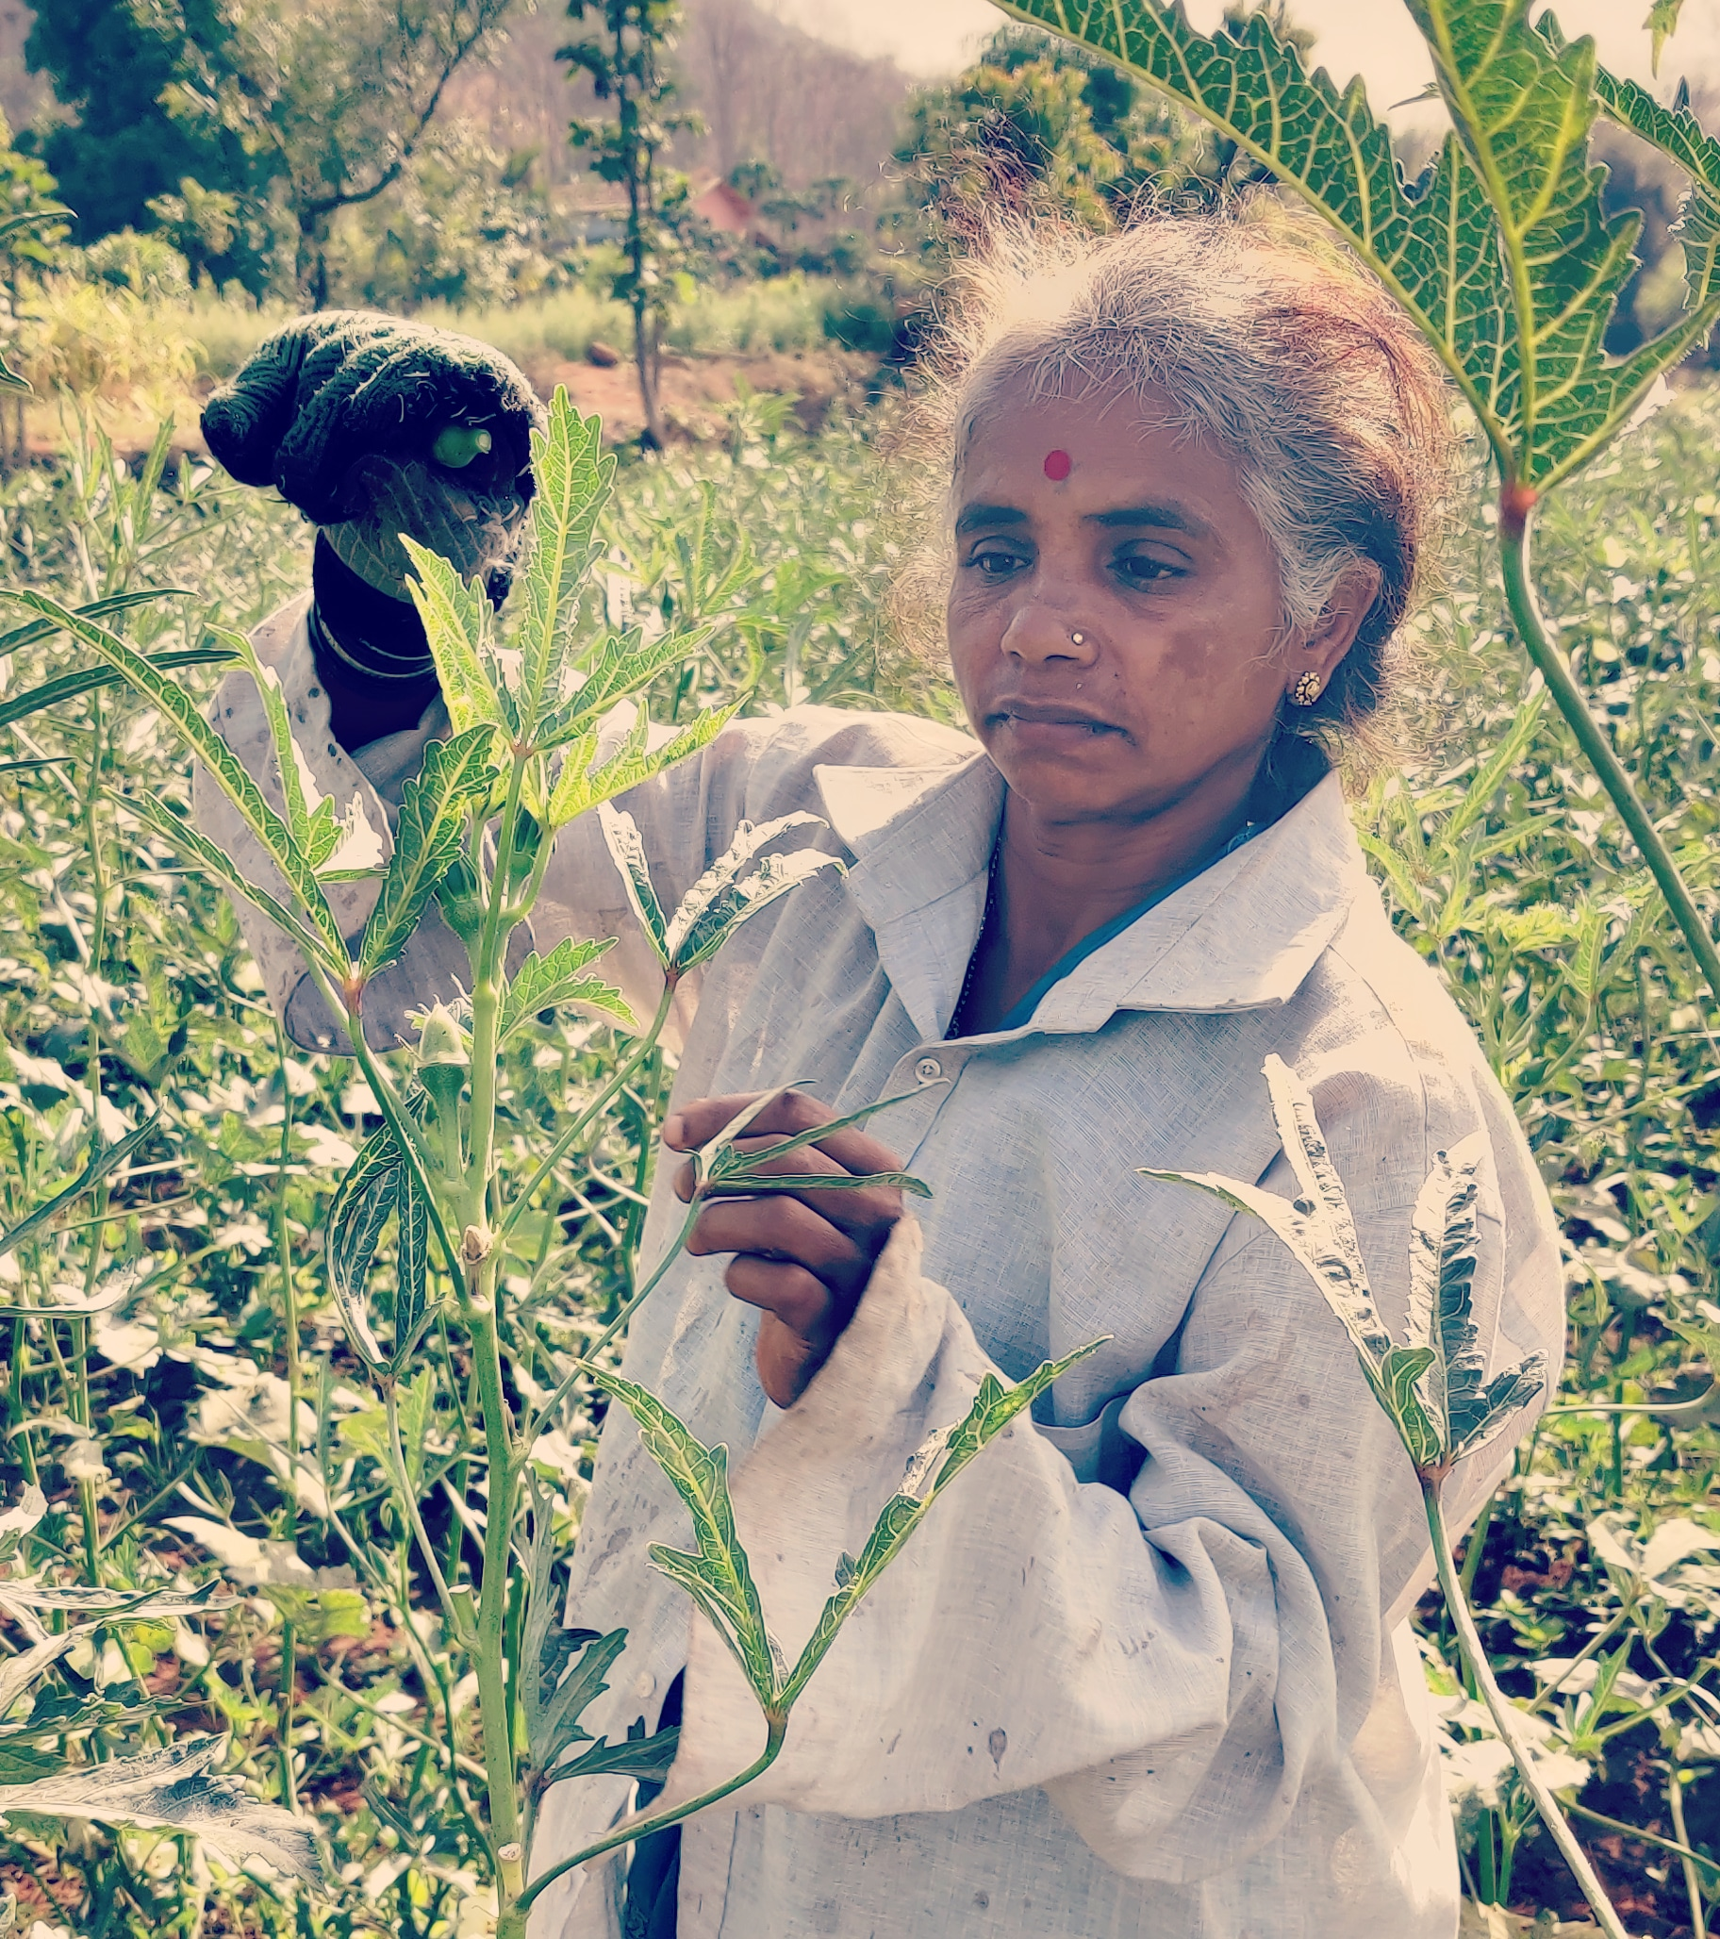
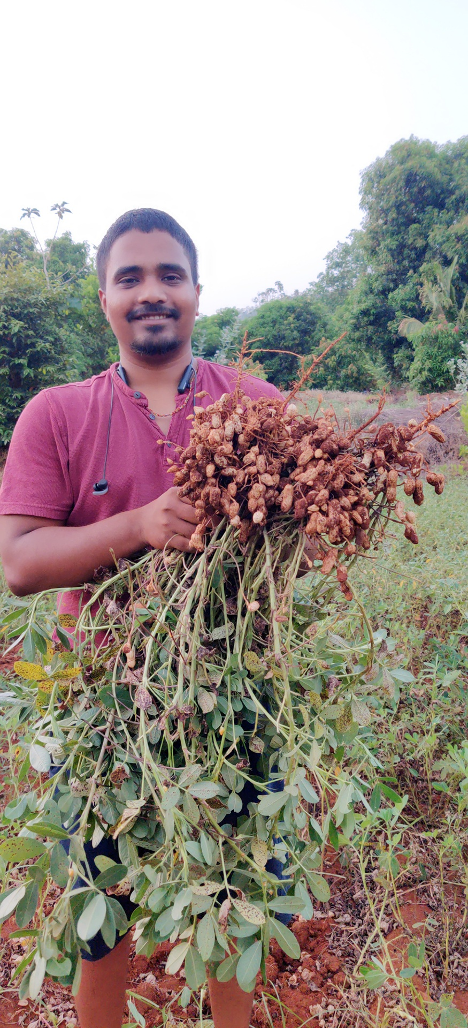
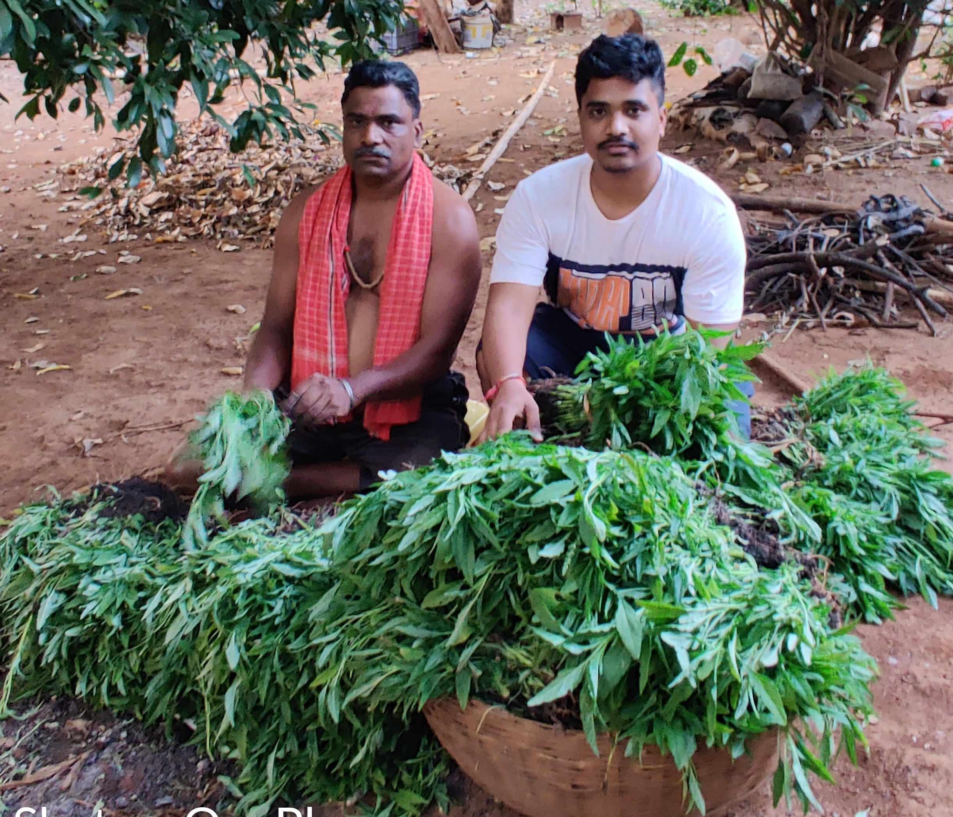

Slide 27
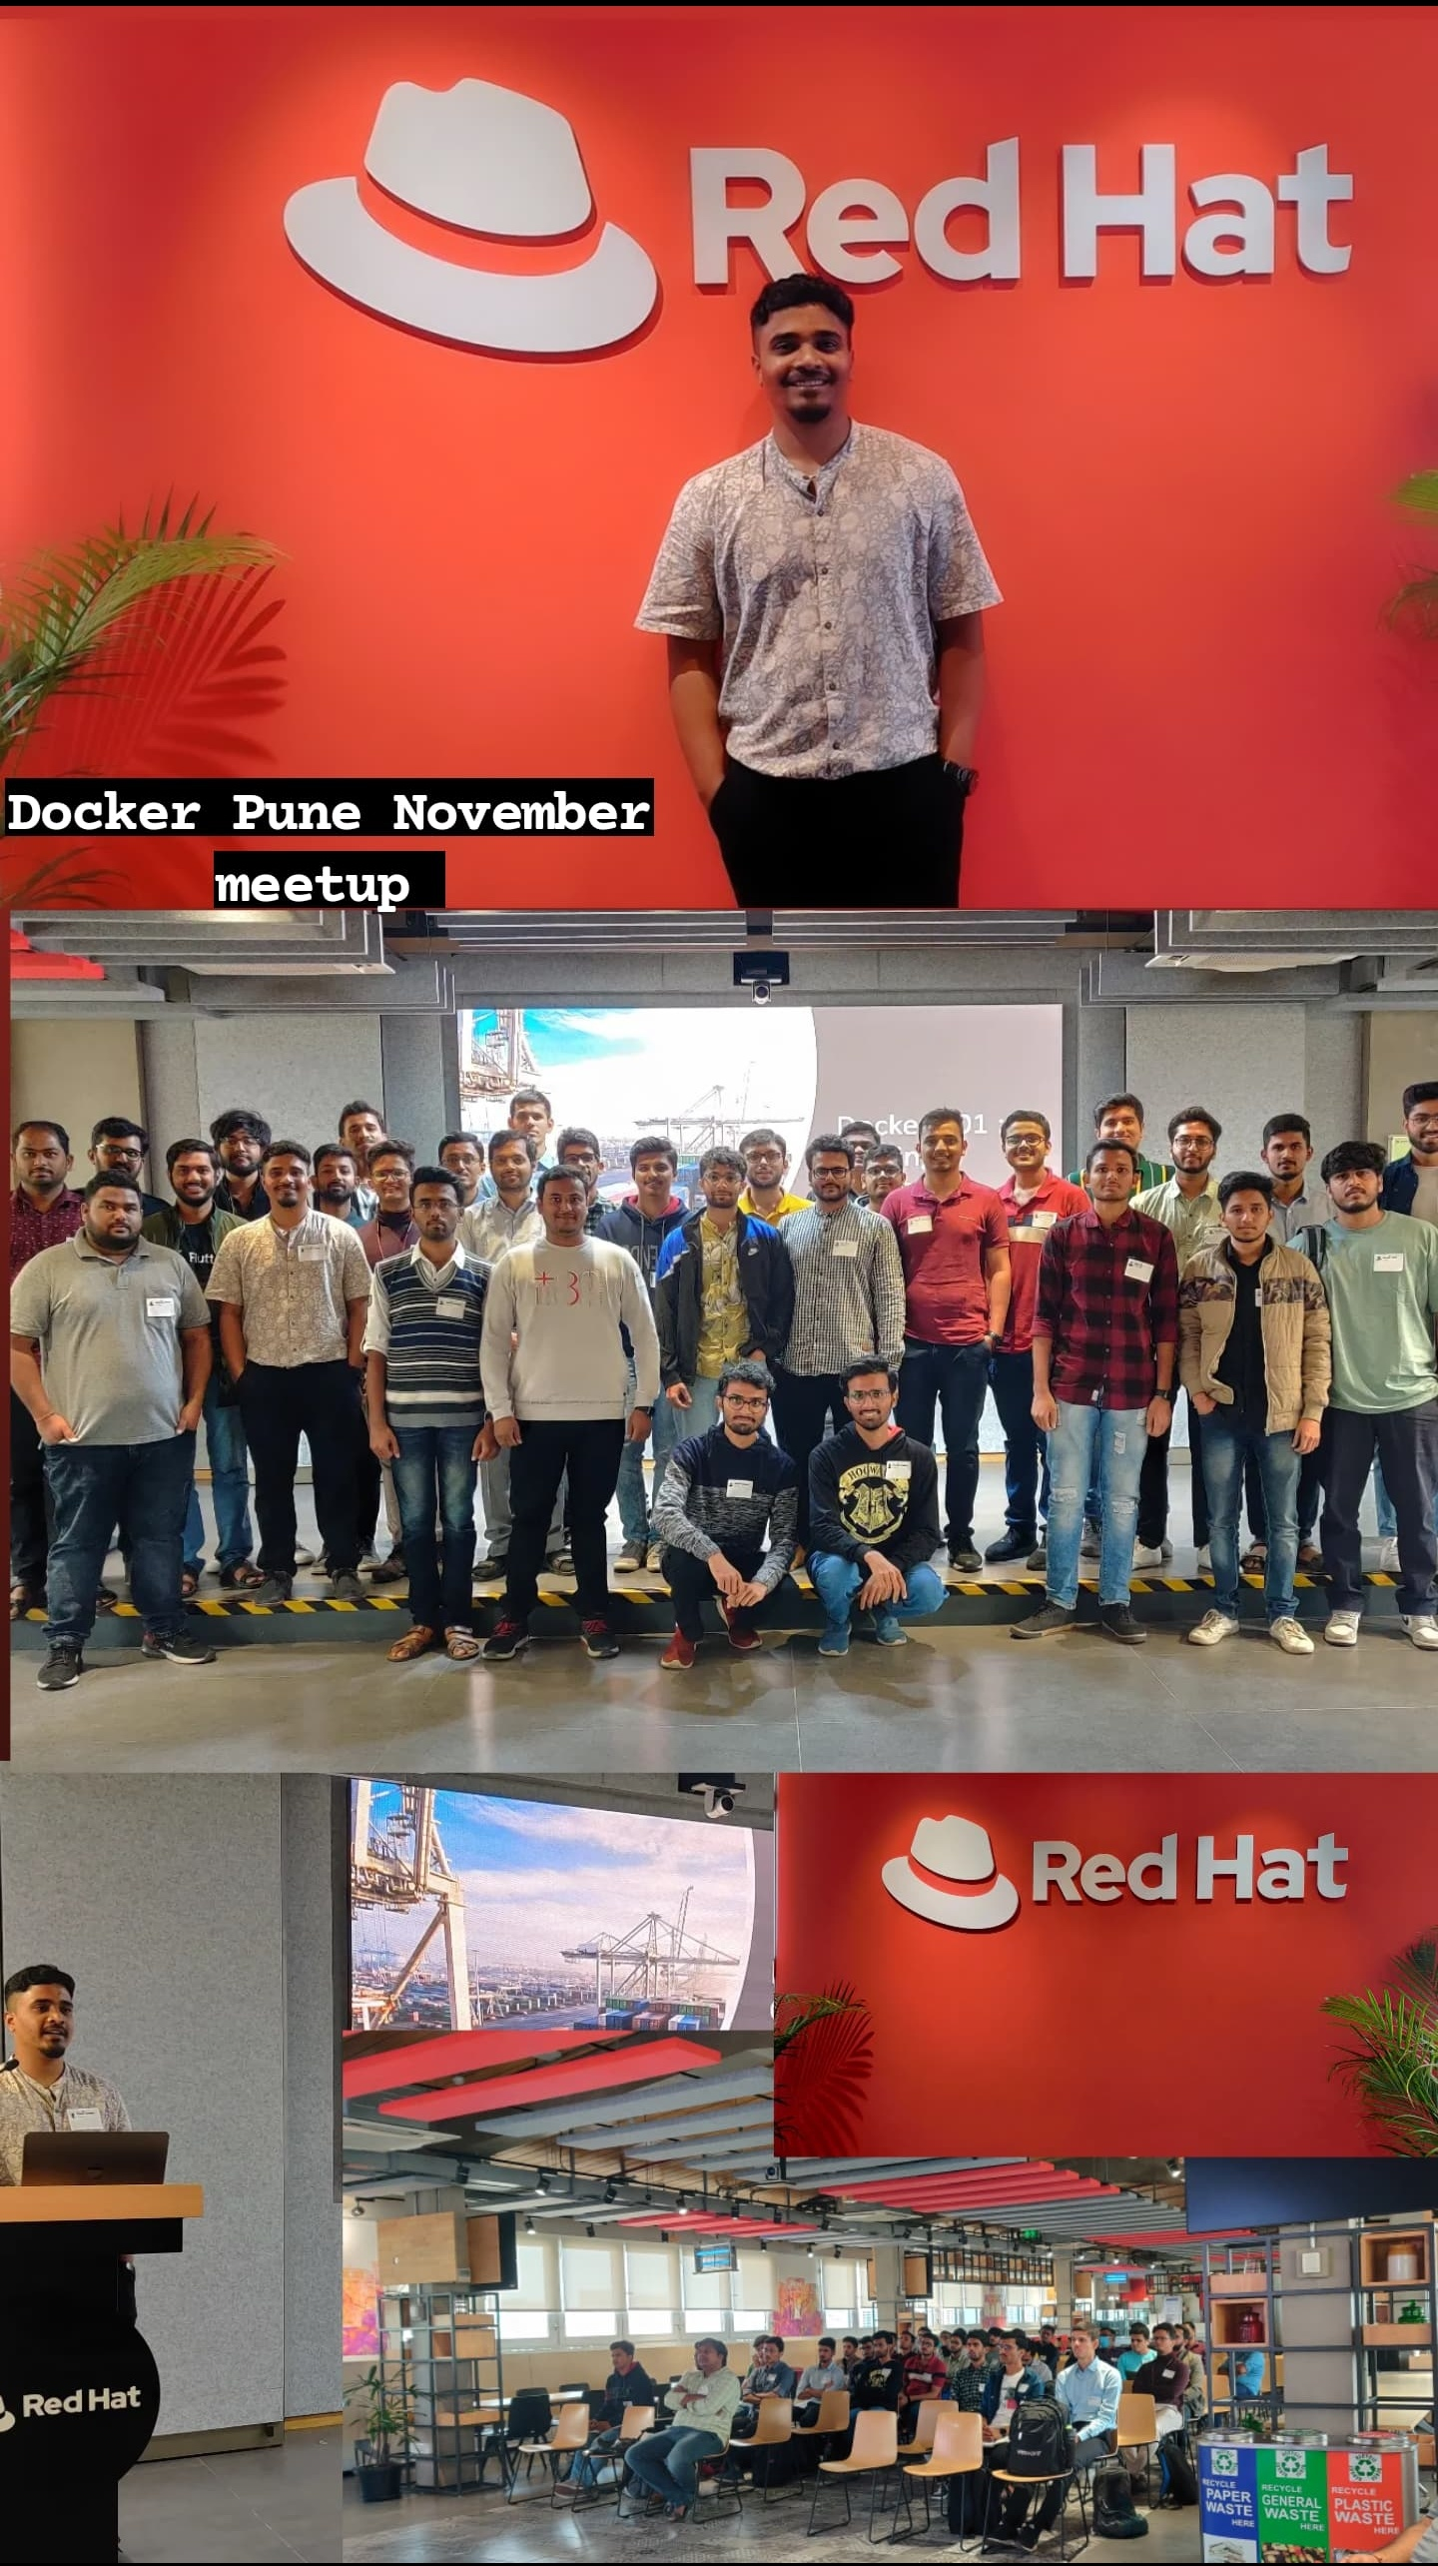
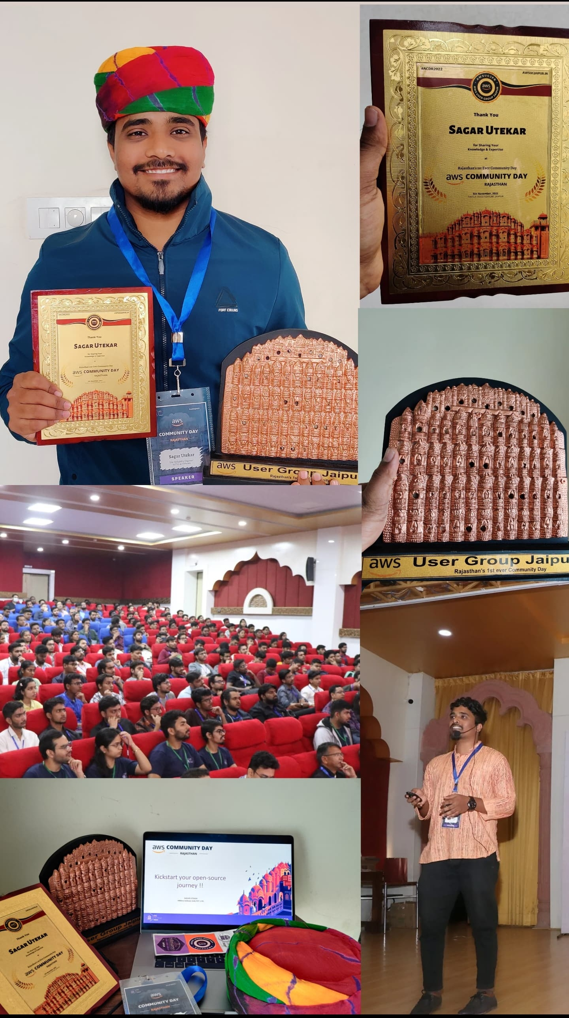
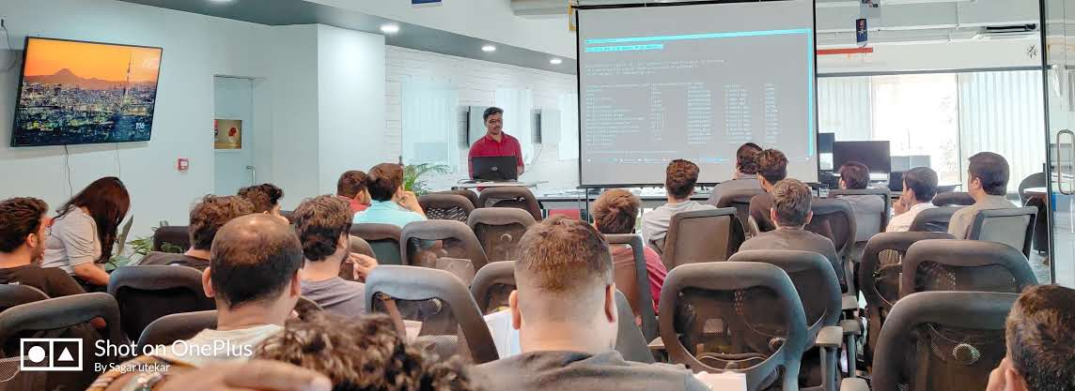
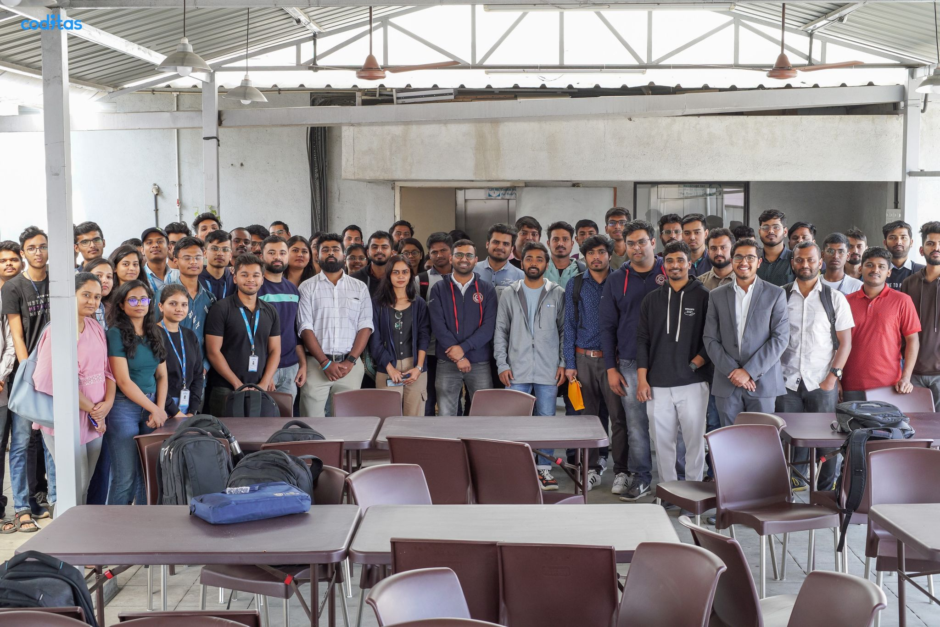
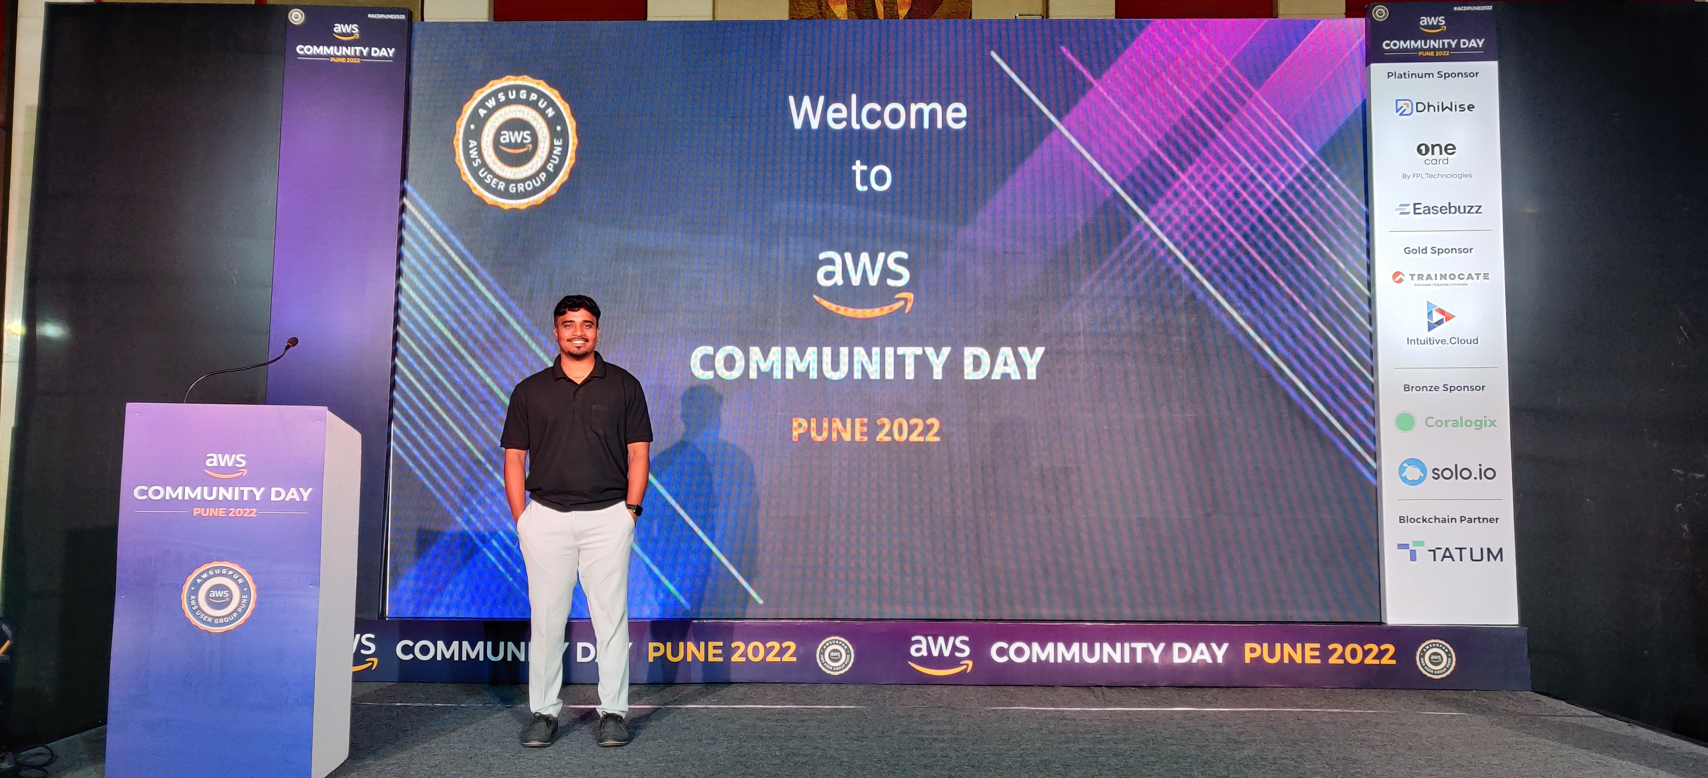

Slide 28
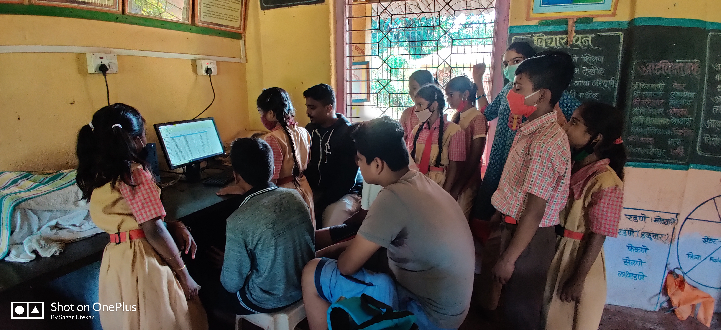
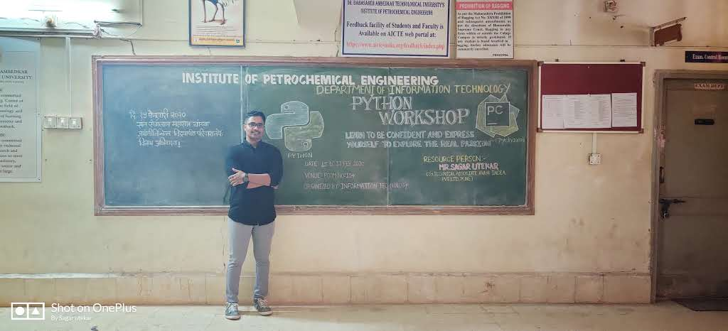
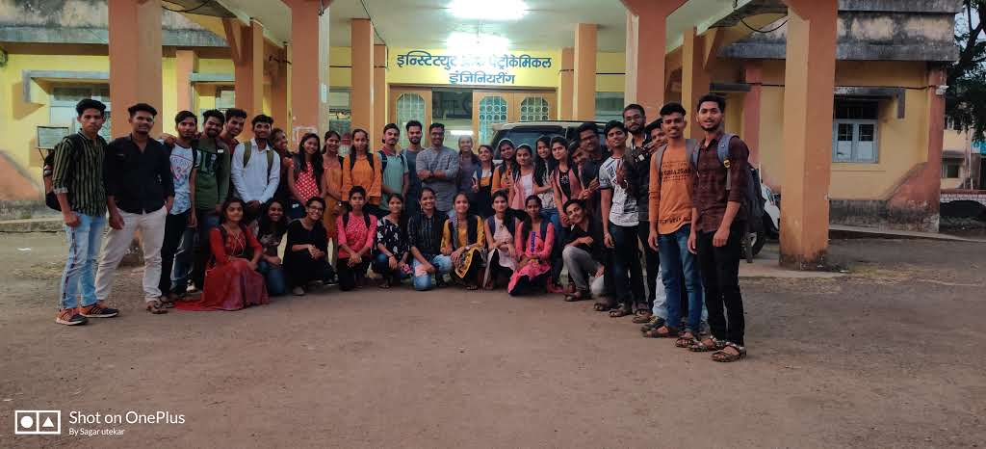
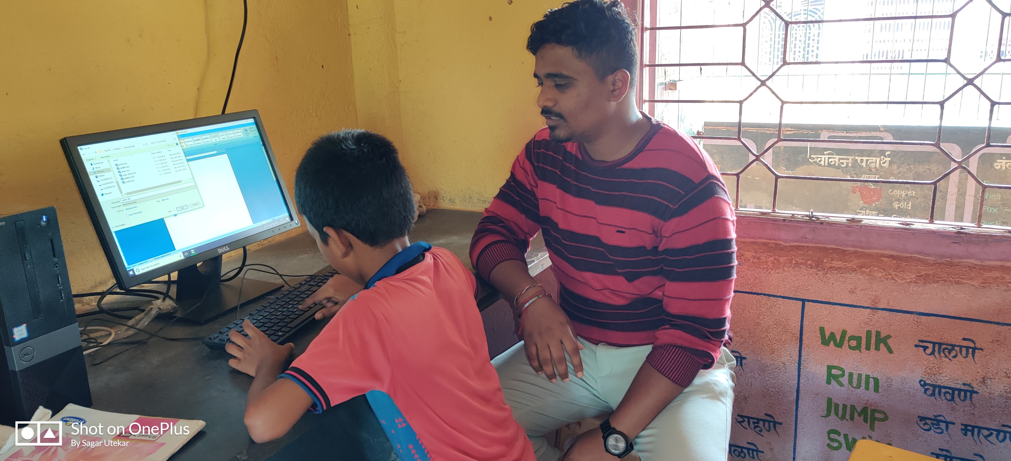
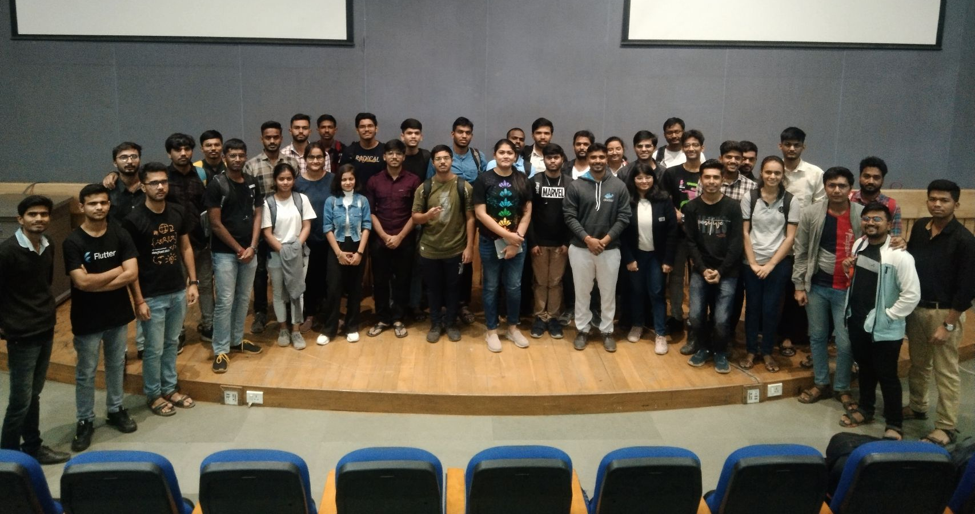

Slide 29
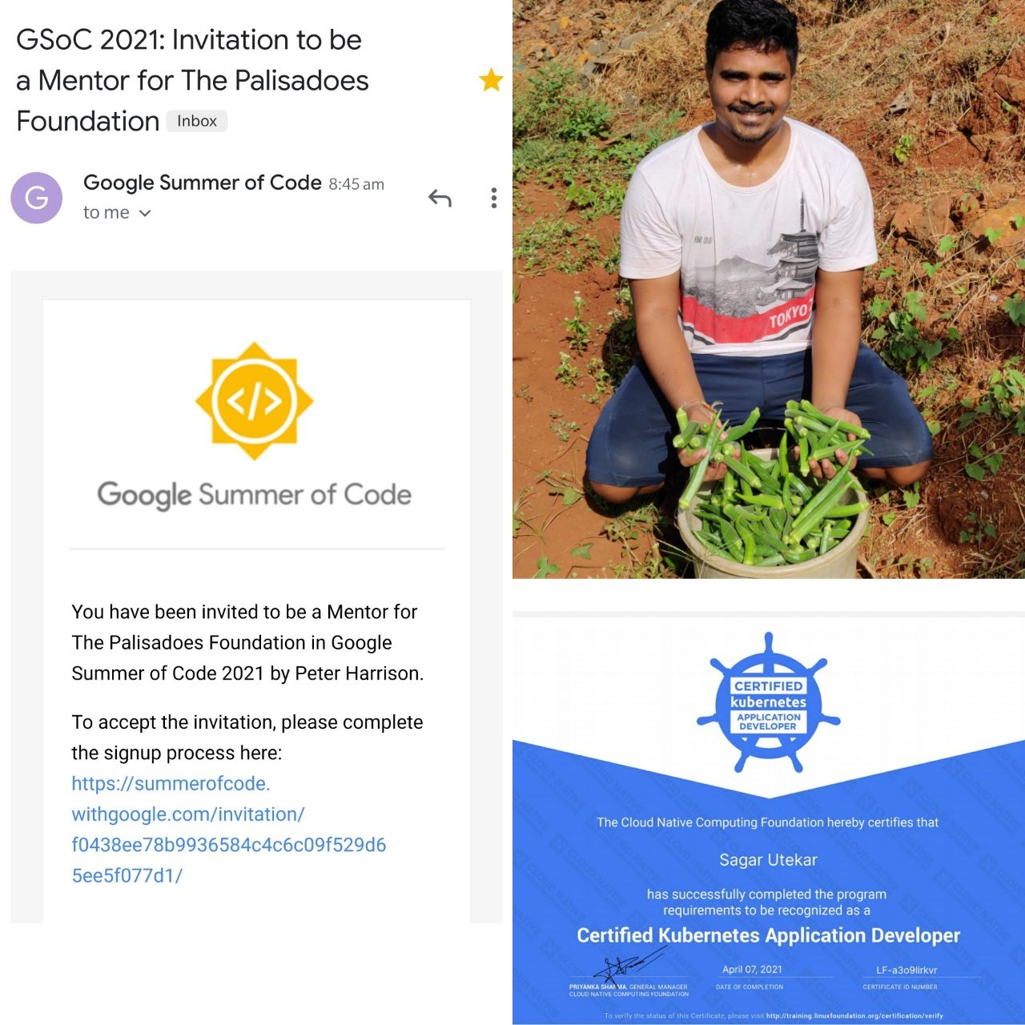
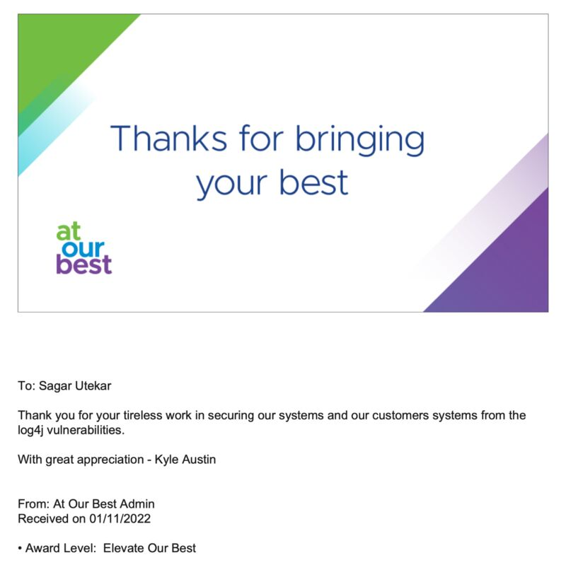
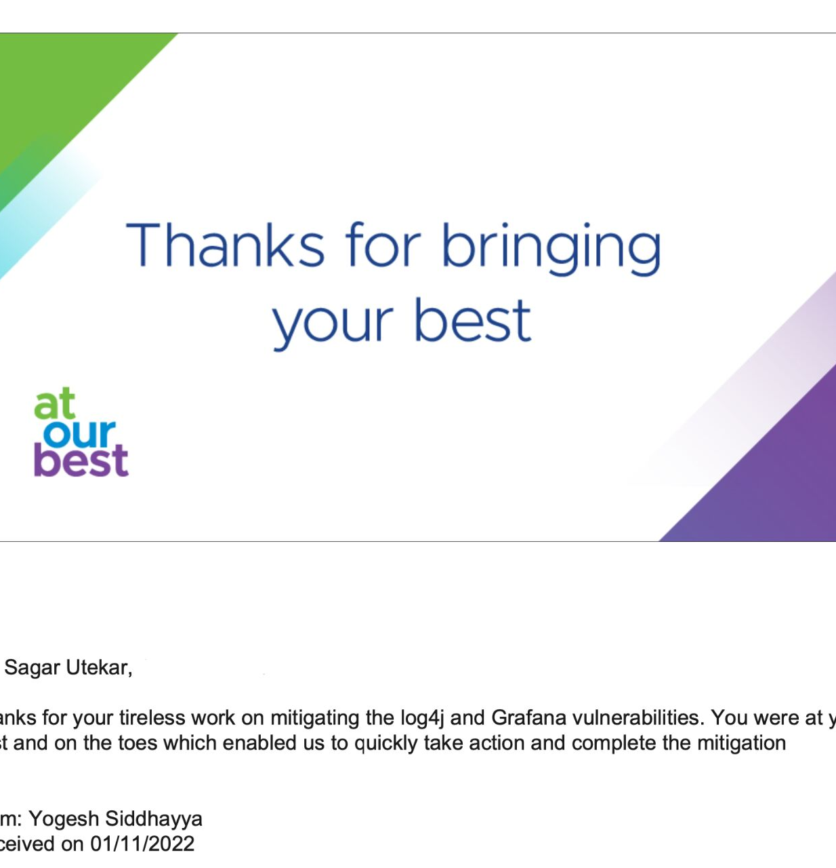
Balancing between interest and office work

Slide 30
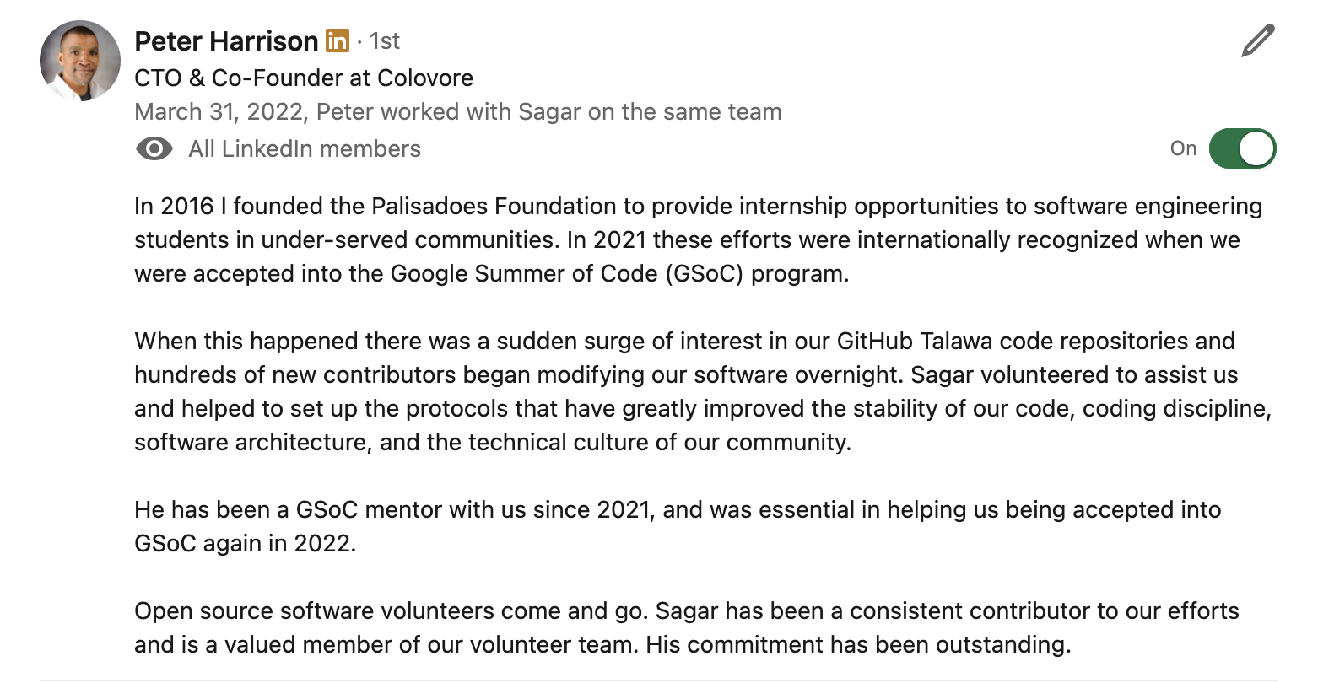
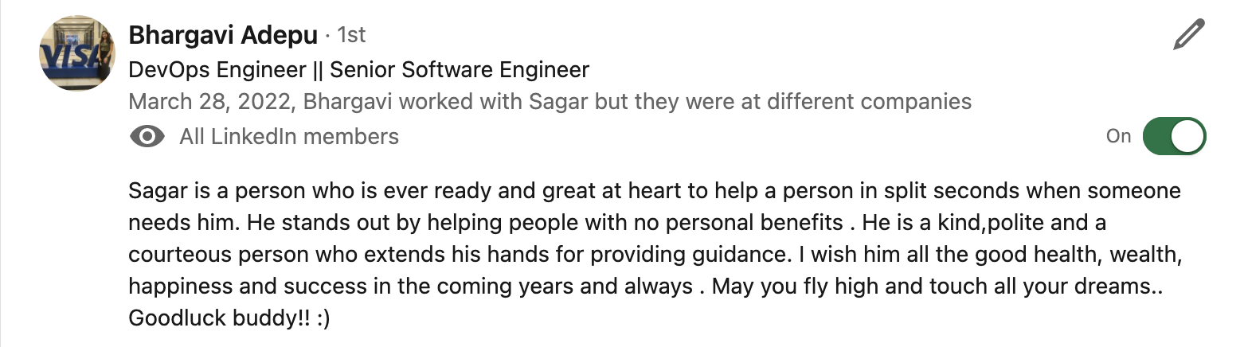
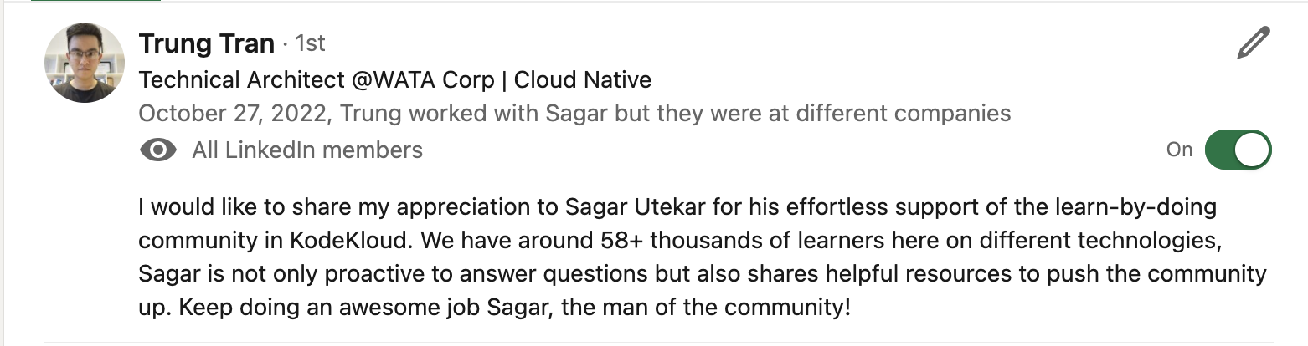
TESTIMONIALS

Slide 31
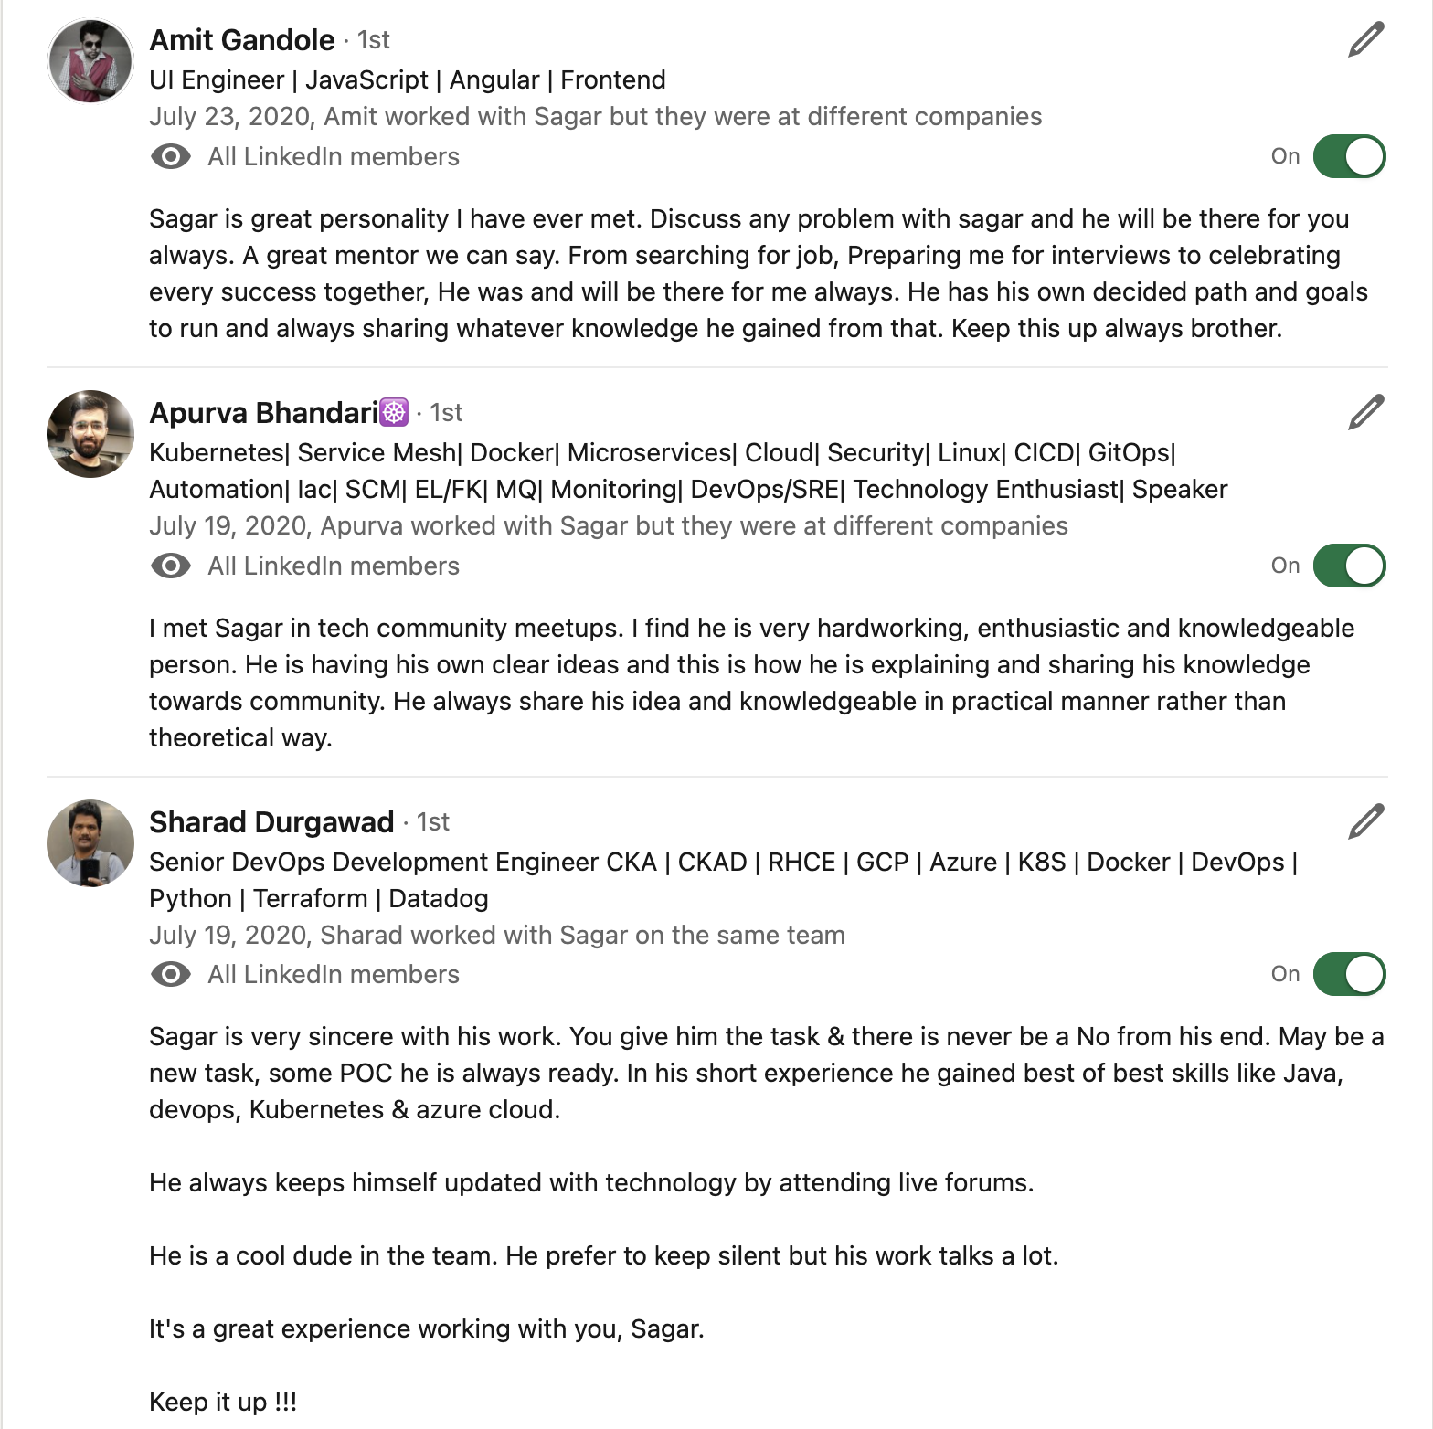
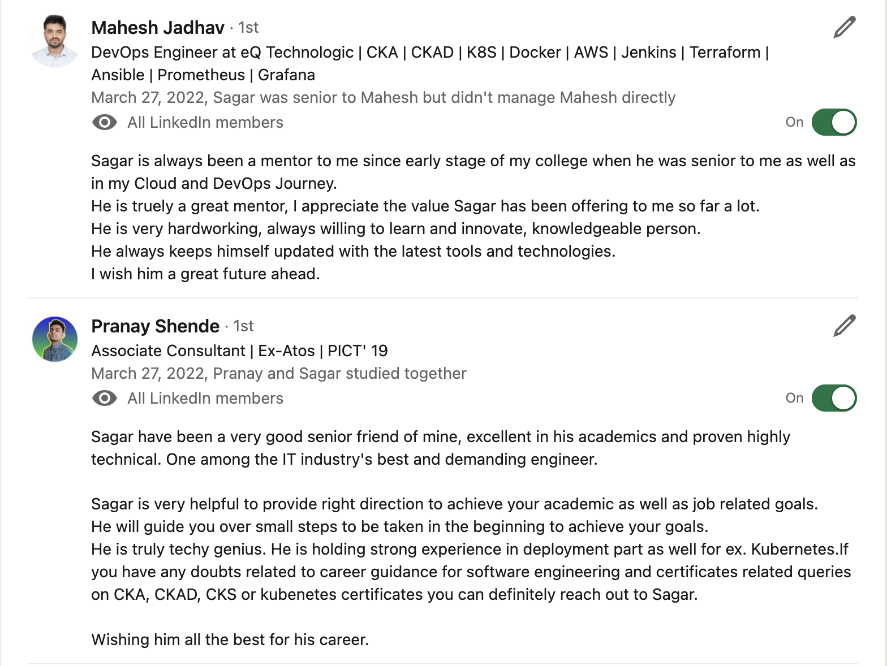
TESTIMONIALS

Slide 32

Community Links
Docker Pune Slack - https://lnkd.in/dyV7VDK6 Docker Pune LinkedIn group - https://lnkd.in/dDZdJRV7
Docker Pune meet-up group - https://lnkd.in/dJhqR8Cj
CNCF Pune meetup group - https://community.cncf.io/pune/
PEcAN Project Slack - https://pecanproject.github.io/contact.html
The Palisadoes Foundation Slack - https://www.palisadoes.org/slack/

Slide 33
Connect with me
https://www.linkedin.com/in/sagar-utekar/
https://twitter.com/me_sagar_utekar
https://github.com/Sagar2366

Slide 34

Thank You

